Slide 2
Status Report BCI: SSVEP
Group 31• 15.02.18
Prashanth H C
Pavan Kumar D
Sawan Singh Mahara
Lakshmiraj
Mrs. Vidya T V
Assistant Professor, PESIT-BSC

Slide 3
Brief Overview

Slide 4
Training
Digital
EEG Database
EEG Extraction
Data Matrix
Covariance Matrix
Centroid Computation
Training Achieved

Slide 5
Testing
New
EEG Database
Epoch Extraction
Data Matrix
Covariance Matrix
Minimum distance to centroid cluster
Predicted Class

Slide 6
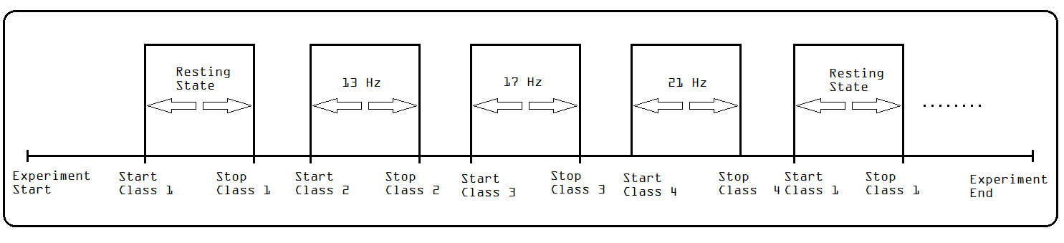
Data Recording Format

Slide 7
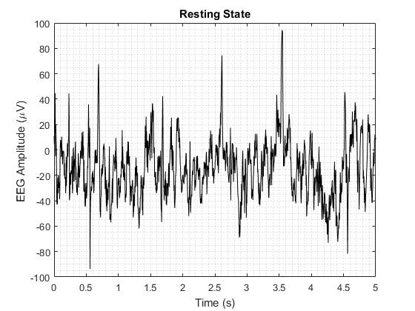
Normal EEG

Slide 8
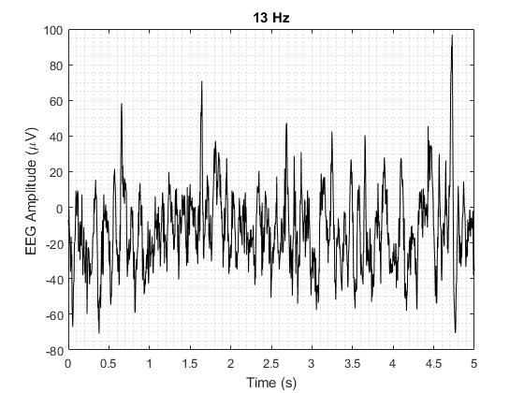
EEG in SSVEP

Slide 9
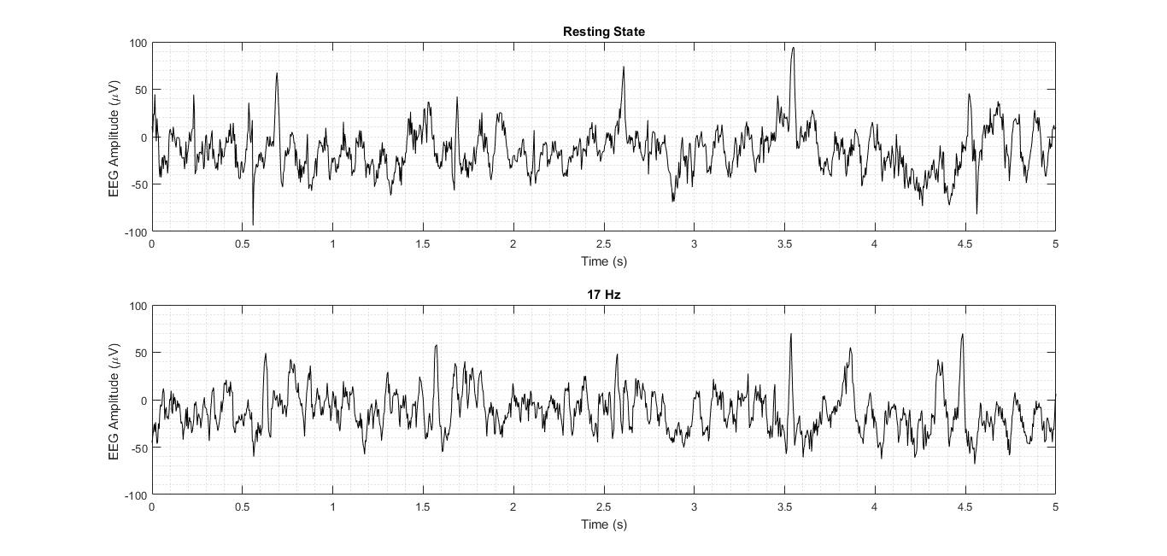

Slide 11

$$The Original ′Vector′$$

Slide 12
Thank You

